Slide 1


User Engagement and Course Performance Analysis using SQL
(SQL Data Analysis)
- Harsh Kumar Gupta
harshkumargupta49
harshkumarguptagit

Slide 2

Understanding Dataset
Source :
Tables used:
Tracks
Course
Topic
Lesson
User_lesson_progress
Registrations
User_feedback

Slide 3
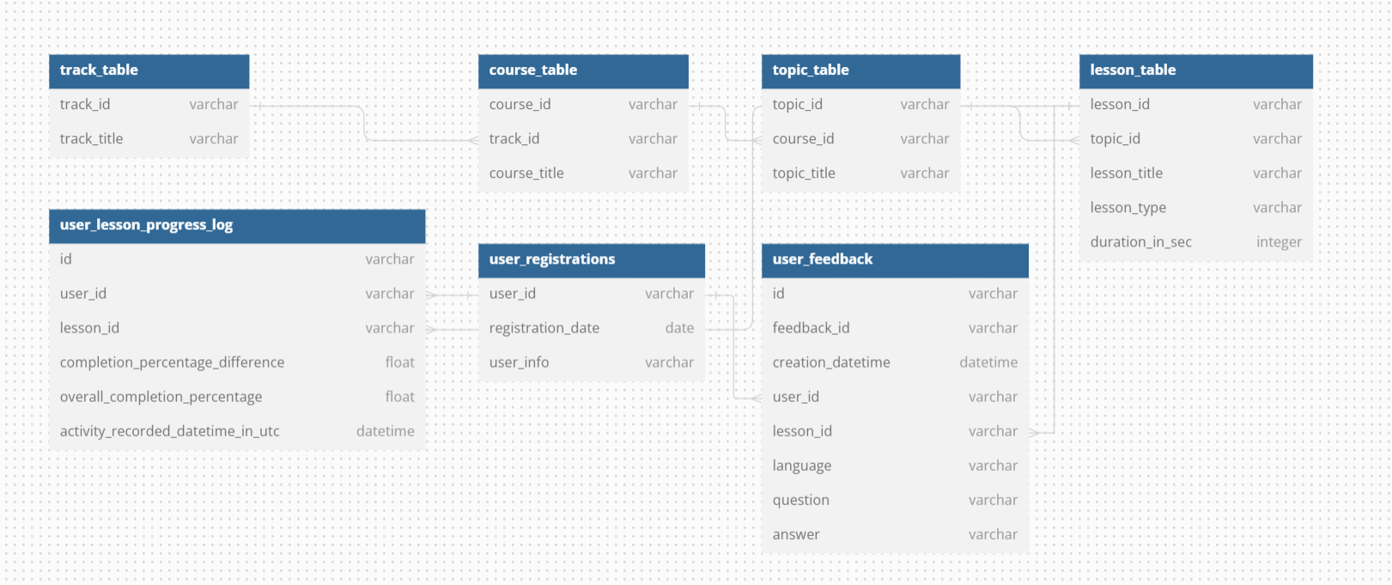
Database Schema

Slide 4
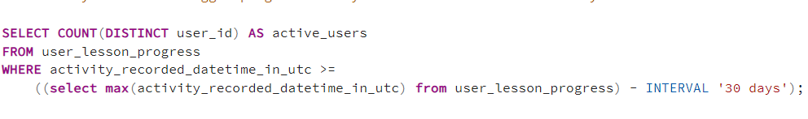

How many users have logged progress in any lesson within the last 30 days?
QUERY
OUTPUT

Slide 5
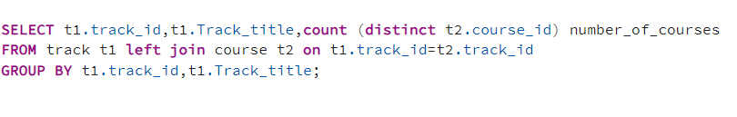
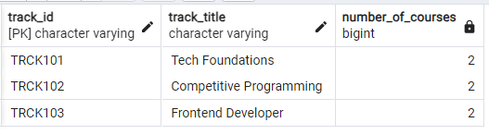
How many courses are available for each track?
QUERY
OUTPUT

Slide 6
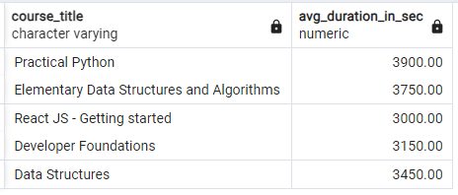
What is the average duration of lessons in each course?
QUERY
OUTPUT

Slide 7
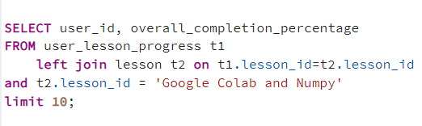
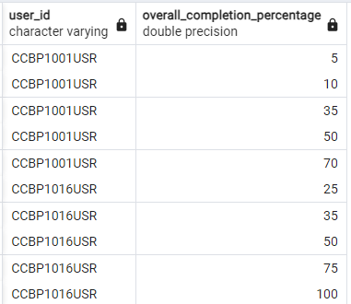
What is the overall completion percentage for each user on 'Google Colab and Numpy' lesson?
QUERY
OUTPUT

Slide 8
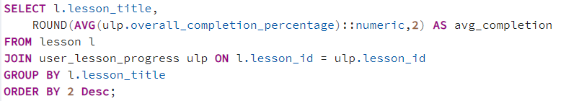
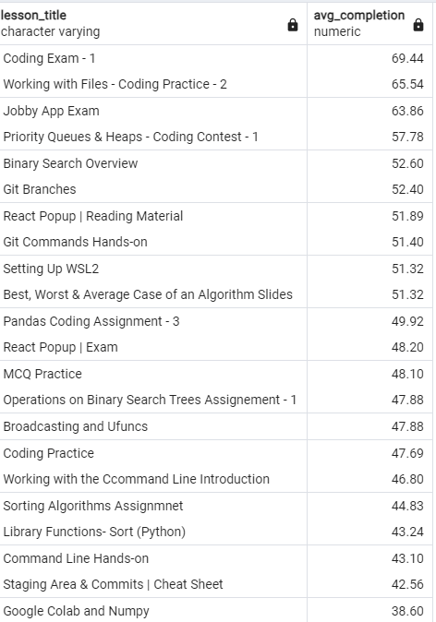
What is the average completion percentage of lessons across all users?
QUERY
OUTPUT

Slide 9
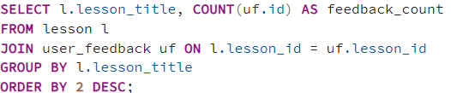
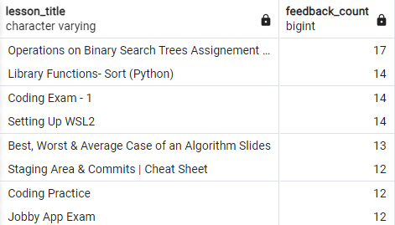
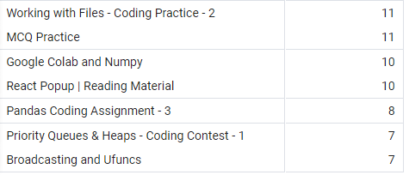
How many feedback entries have been submitted for each lesson?
QUERY
OUTPUT

Slide 10
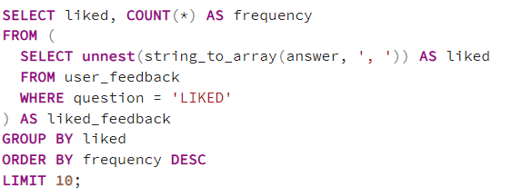
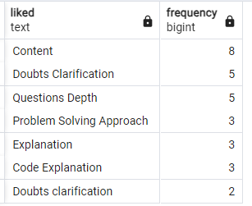
What are the most common aspects mentioned in user feedback for the category "LIKED”?
QUERY
OUTPUT

Slide 11
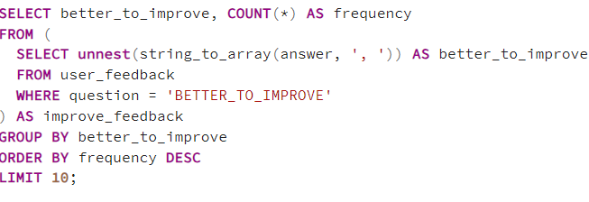
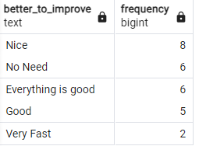
What are the most common aspects mentioned in user feedback for the category "BETTER_TO_IMPROVE”?
QUERY
OUTPUT

Slide 12
How many users have logged progress in any lesson within the last 30 days?
QUERY
OUTPUT

Slide 13
THANK YOU
harshkumargupta49
HarshKumarGuptagit

